Slide 1
Stroke Dataset A Classification Problem
Manish Gunjal
PGA-13 / Thane
Capstone Project 2

Slide 2
Contents:
Objective / Problem Statement
Dataset Description
Importing the data
Exploratory Data Analysis (EDA)
Data Cleaning / Data Pre-processing
Model Building
Model Evaluation
Real-World Application

Slide 3
Objective / Problem Statement:
According to the World Health Organization (WHO) stroke is the 2nd leading cause of death globally, responsible for approximately 11% of total deaths. In this project we are going to predict whether a patient is likely to get stroke based on the input parameters like gender, age, various diseases, and smoking status, etc.
In this project, we are using Jupyter Notebook to create a machine learning model on the stroke dataset.

Slide 4
Dataset Description:-
id: unique identifier
gender: "Male", "Female" or "Other“
age: age of the patient
hypertension: 0 if the patient doesn't have hypertension, 1 if the patient has hypertension
heart_disease: 0 if the patient doesn't have any heart diseases, 1 if the patient has a heart disease
ever_married: "No" or "Yes“
work_type: "children", "Govt_job", "Never_worked", "Private" or "Self-employed“
Residence_type: "Rural" or "Urban“
avg_glucose_level: average glucose level in blood
bmi: body mass index
smoking_status: "formerly smoked", "never smoked", "smokes" or "Unknown“
stroke: Yes if the patient had a stroke or No if not

Slide 5
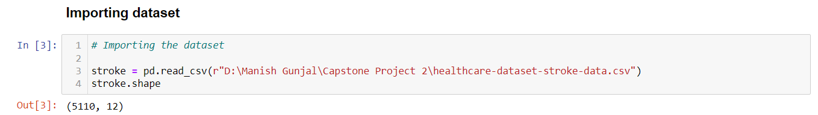
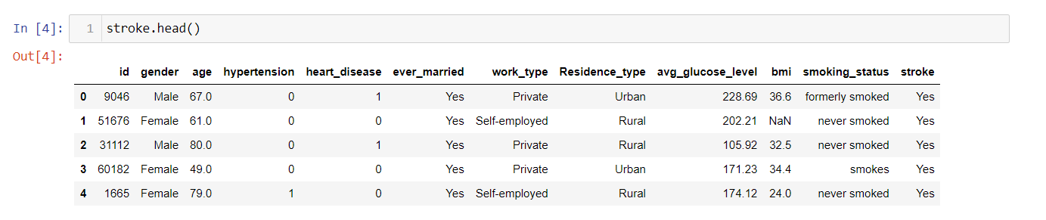
Importing the data:-
Dataset Preview:

Slide 6
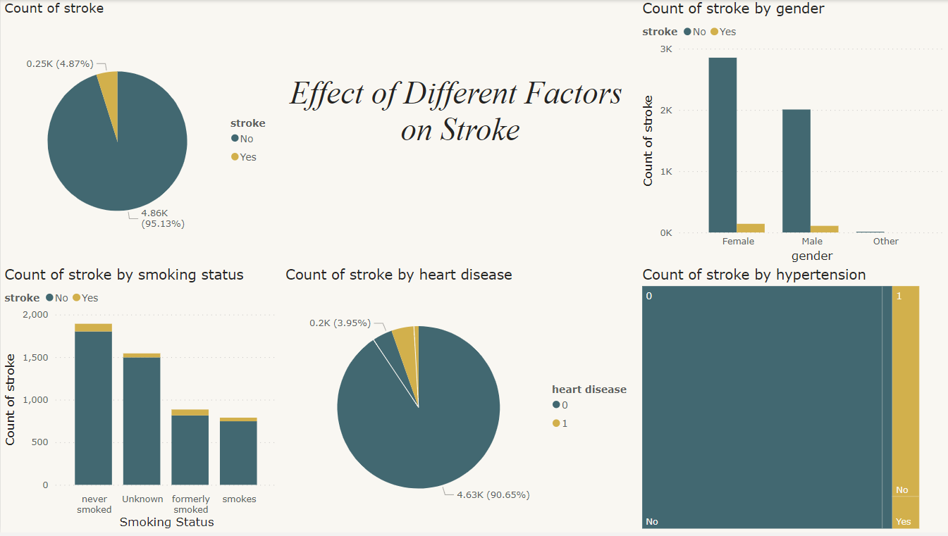
Exploratory Data Analysis:-

Slide 7
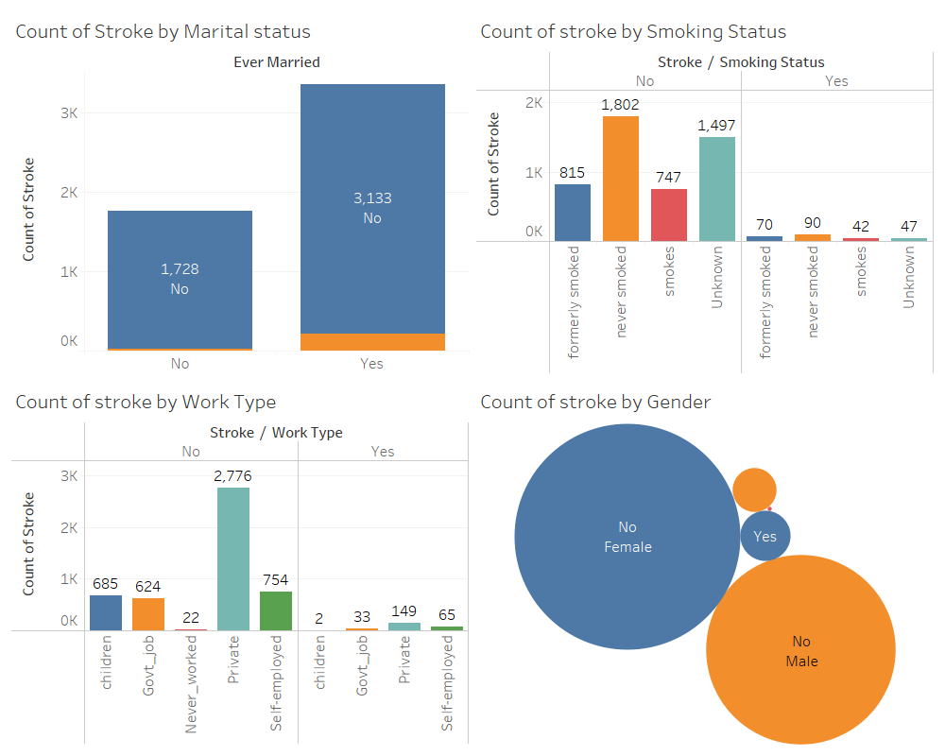

Slide 8
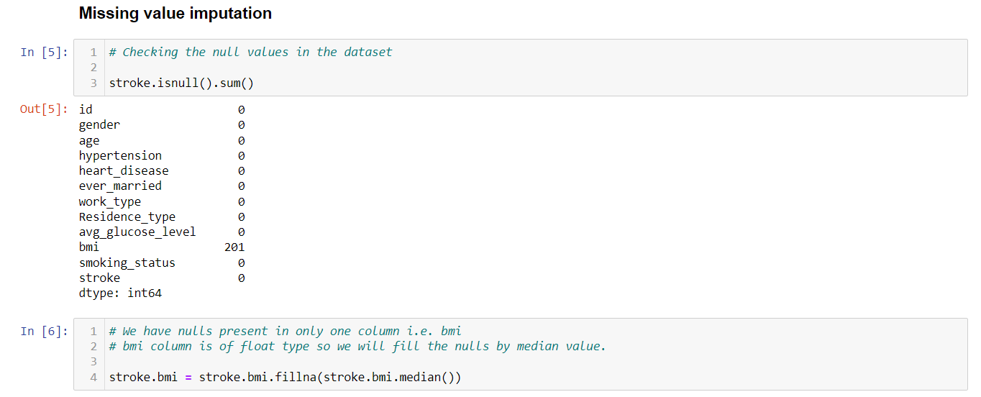
Data Pre-processing:-
Missing Value Imputation

Slide 9
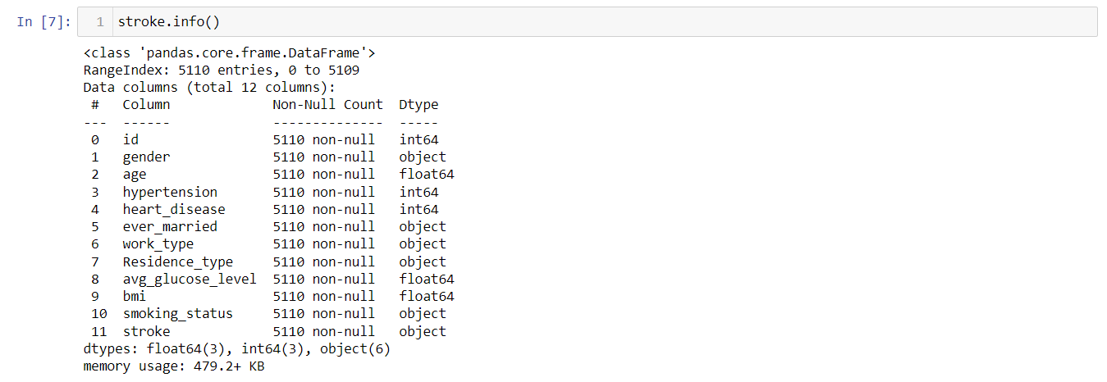
Removing Id Column
Converting categorical data into numeric

Slide 10
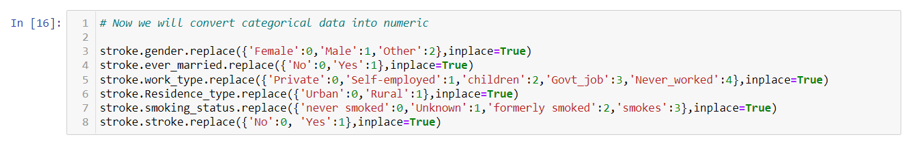
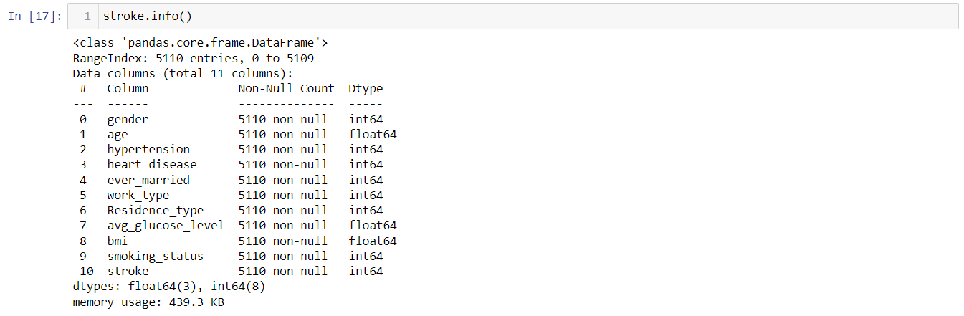
Confirming if all the columns are converted into numeric or not

Slide 11
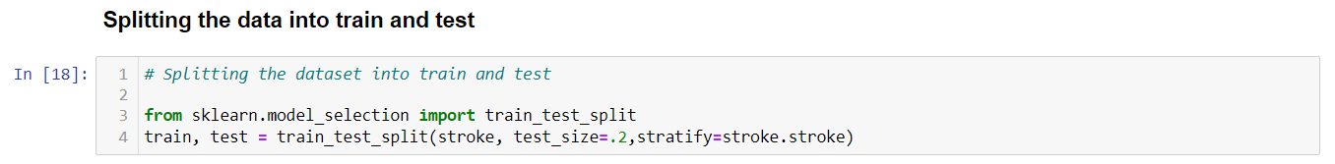
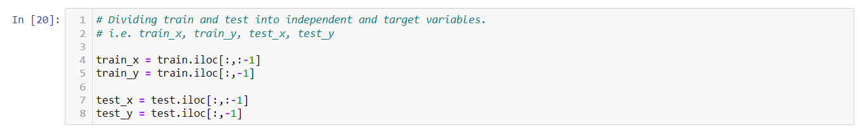
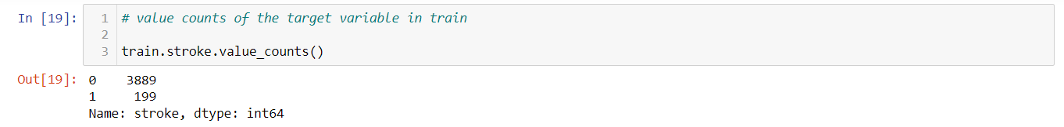
Splitting the data into train and test
Checking if there is a problem of Class Imbalance

Slide 12
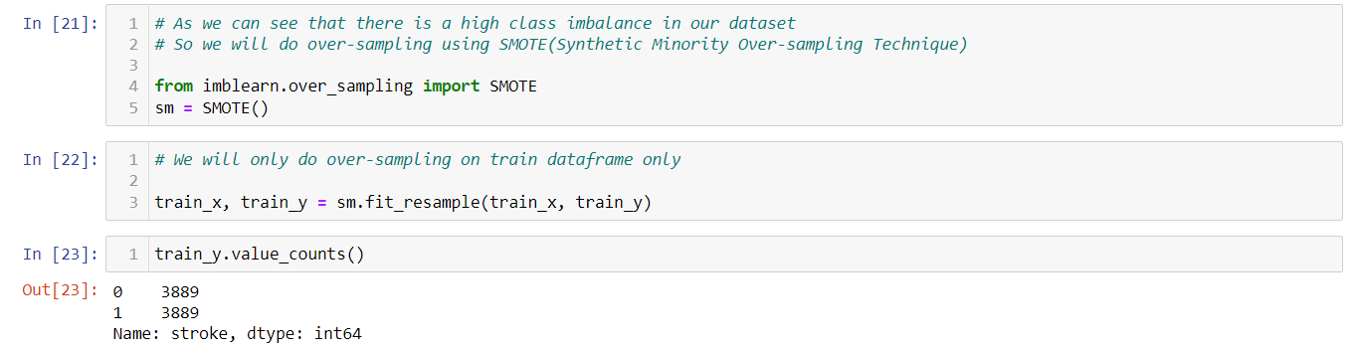
As we can see that there is a problem of class imbalance so we will do SMOTE here…
After doing SMOTE, we can see that now the records or class 0 and class 1 is equal…

Slide 13
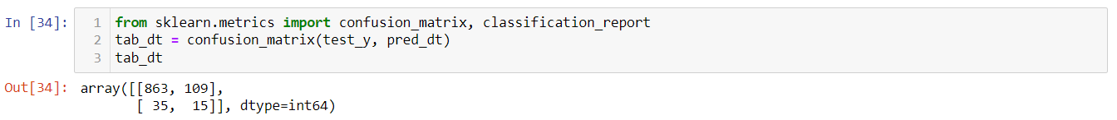
Model Building:-
We will try multiple algorithms to see that which model is performing good.
These are some of the algorithms that I’ve tried:
Decision Tree:
Random Forest:

Slide 14
K- Nearest Neighbors:
Support Vector Machine:
Logistic Regression:
Voting Classifier:

Slide 15
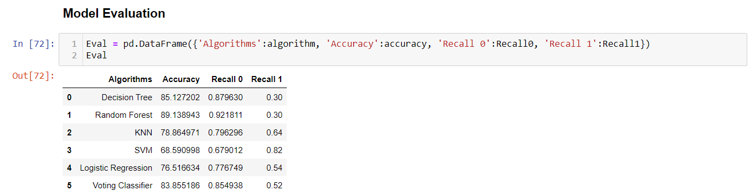
Model Evaluation:-
To evaluate the models and see whether performance of which model is better, We’ve created a data frame showing the accuracy as well as Recall 0 (TNR) and Recall 1 (TPR).
We will evaluate our models based on these three factors.

Slide 16
We can see that all the models are giving good value of Accuracy and Recall 0 but most of the models are highly failing for Recall 1. In our problem statement, we want to predict whether the patient is likely to get a stroke or not.
So we are focusing on mainly on class 1 i.e. patients who got a stroke. We will select that model which is giving good value of Recall 1 because Recall 1 is giving us….. how many predictions are correct out of Actual class 1 records.

Slide 17
Real-World Applications:
Stroke is a life-threatening medical illness that should be treated as soon as possible to avoid further complications. The development of an ML model could aid in the early detection of stroke and the subsequent mitigation of its severe consequences. The effectiveness of several ML algorithms in properly predicting stroke based on a number of physiological variables is investigated in this study. Support Vector Machine outperforms the other methods tested. The future scope of this study is that using a larger dataset and machine learning models, such as AdaBoost, SVM, and Bagging, the framework models may be enhanced. In exchange for just providing some basic information, the machine learning architecture may help the general public in determining the likelihood of a stroke occurring in a patient. In an ideal world, it would help patients obtain early treatment for strokes.

Slide 18
Thank You

